Slide 1
Unsupervised Learning Competitive Learning
CSE301 Bio-computation, weeks 10, 2016
Bailing Zhang
Computer Science & Software Eng

Slide 2
Clustering Revisit
Cluster analysis organizes data by abstracting the underlying structure either as a grouping of individuals, or as a hierarchy of groups.
These groupings are based on measured or perceived similarities among the patterns.
Clustering is unsupervised. There are no category labels and other information about the source of data.

Slide 3





























































































Why do we need clustering?
Example

Slide 4
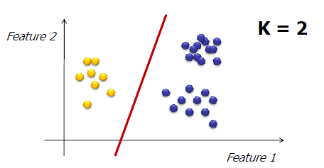
K-means algorithm
The k-means algorithm partitions the data into k mutually exclusive clusters, e.g.

Slide 5
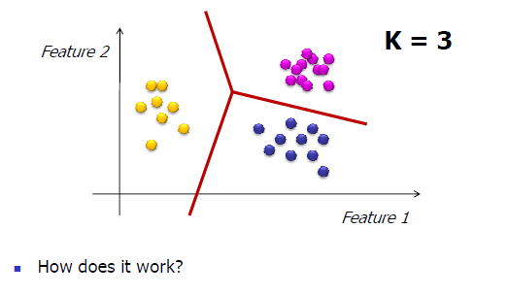
K-means algorithm
The k-means algorithm partitions the data into k mutually exclusive clusters
How does it work?

Slide 6
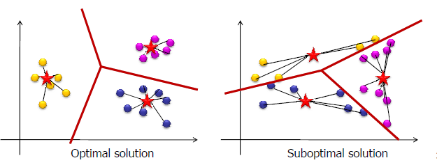
K-means algorithm
Formal definition:
Minimize total intra-cluster variance
S_{i} is the ith cluster (i=1,2,…K)
μ_{i} is the ith centroid of the points in cluster S_{i}
d is the distance function

Slide 7
K-means algorithm
If we knew the cluster assignment of each point we could easily compute the centroids positions
If we knew the centroid positions we could easily assign each point to a cluster
But we don’t know neither of them

Slide 8
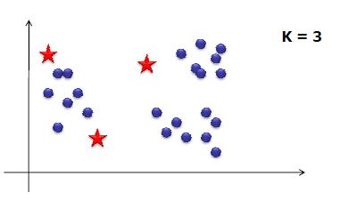
k-means algorithm
Algorithm description
Choose the number of clusters, k
Randomly choose initial positions of k centroids
Assign each of the points to the “nearest centroid” (depends on distance measure)

Slide 9
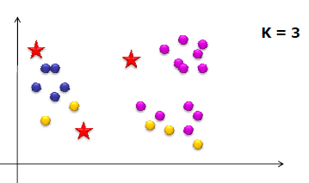
k-means algorithm
Algorithm description
Choose the number of clusters - k
Randomly choose initial positions of k centroids
Assign each of the points to the “nearest centroid” (depends on distance measure)

Slide 10
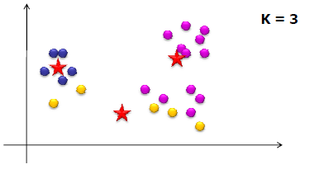
k-means algorithm
Algorithm description
Choose the number of clusters - k
Randomly choose initial positions of k centroids
Assign each of the points to the “nearest centroid” (depends on distance measure)
Re-compute centroid positions
If solution converges Stop!

Slide 11
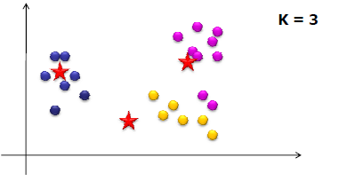
k-means algorithm
Algorithm description
Choose the number of clusters - k
Randomly choose initial positions of k centroids
Assign each of the points to the “nearest centroid” (depends on distance measure)
Re-compute centroid positions
If solution converges Stop!

Slide 12
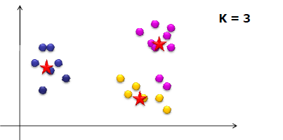
K-means algorithm
Algorithm description
Choose the number of clusters - K
Randomly choose initial positions of K centroids
Assign each of the points to the “nearest centroid” (depends on distance measure)
Re-compute centroid positions
If solution converges Stop!

Slide 13
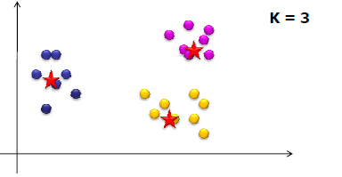
k-means algorithm
Algorithm description
Choose the number of clusters - k
Randomly choose initial positions of k centroids
Assign each of the points to the “nearest centroid” (depends on distance measure)
Re-compute centroid positions
If solution converges Stop!

Slide 14
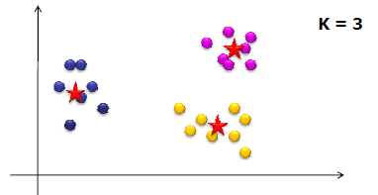
k-means algorithm
Algorithm description
Choose the number of clusters - k
Randomly choose initial positions of k centroids
Assign each of the points to the “nearest centroid” (depends on distance measure)
Re-compute centroid positions
If solution converges Stop!

Slide 15
k-means: things we need to consider
Does the algorithm guarantee convergence to an optimal solution?
Can you think of strategies for solving this...
.
.
.

Slide 16
Unsupervised Competitive Learning
In Hebbian networks, all neurons can “fire” at the same time
Competitive learning means that only a single neuron from each group fires at each time step
Output units compete with one another.
These are winner takes all units (grandmother cells)

Slide 17
Winner-takes-all (WTA)
Among all competing nodes, only one will win and all others will lose
We mainly deal with single winner WTA, but multiple winners WTA are possible (and useful in some applications)
Easiest way to realize WTA: have an external, central arbitrator (a program) to decide the winner by comparing the current outputs of the competitors (break the tie arbitrarily)
This is biologically unsound (no such external arbitrator exists in biological nerve system!).

Slide 18
Unsupervised Competitive Learning
winner
output
…
input (n-dimensional)

Slide 19
unsupervised competitive learning
• initialize k prototype vectors
present a single example
identify the closest prototype,
i.e., the so-called winner ,
move the winner even
closer towards the example
intuitively clear, plausible procedure
- places prototypes in areas with high density of data
- identifies the most relevant combinations of features
- (stochastic) on-line gradient descent with respect to
the cost function ...

Slide 20
Simple Competitive Learning
Note: the inner product of two normal vectors is the cosine of the angle between them
Winner:
Lateral inhibition
Winner = output node whose incoming weights are the shortest Euclidean distance from the input vector

Slide 21
Simple Competitive Learning
Possible ways to update weights for winning neuron
The neuron with largest activation is then adapted
to be more like the input
that caused the excitation
Only the incoming weights of the winner node are modified.

Slide 22
Simple Competitive Learning
Update rule for all neurons:

Slide 23
Result
Each output unit moves to the center of mass of a cluster of input vectors ➔
clustering

Slide 24
SCL Examples (1)
6 Cases:
(0 1 1) (1 1 0.5)
(0.2 0.2 0.2) (0.5 0.5 0.5)
(0.4 0.6 0.5) (0 0 0)
Learning Rate: 0.5
Initial Randomly-Generated Weight Vectors:
[ 0.14 0.75 0.71 ]
[ 0.99 0.51 0.37 ] Hence, there are 3 classes to be learned
[ 0.73 0.81 0.87 ]
Training on Input Vectors
Input vector # 1: [ 0.00 1.00 1.00 ]
Winning weight vector # 1: [ 0.14 0.75 0.71 ] Distance: 0.41
Updated weight vector: [ 0.07 0.87 0.85 ]
Input vector # 2: [ 1.00 1.00 0.50 ]
Winning weight vector # 3: [ 0.73 0.81 0.87 ] Distance: 0.50
Updated weight vector: [ 0.87 0.90 0.69 ]

Slide 25
SCL Examples (2)
Input vector # 3: [ 0.20 0.20 0.20 ]
Winning weight vector # 2: [ 0.99 0.51 0.37 ] Distance: 0.86
Updated weight vector: [ 0.59 0.36 0.29 ]
Input vector # 4: [ 0.50 0.50 0.50 ]
Winning weight vector # 2: [ 0.59 0.36 0.29 ] Distance: 0.27
Updated weight vector: [ 0.55 0.43 0.39 ]
Input vector # 5: [ 0.40 0.60 0.50 ]
Winning weight vector # 2: [ 0.55 0.43 0.39 ] Distance: 0.25
Updated weight vector: [ 0.47 0.51 0.45 ]
Input vector # 6: [ 0.00 0.00 0.00 ]
Winning weight vector # 2: [ 0.47 0.51 0.45 ] Distance: 0.83
Updated weight vector: [ 0.24 0.26 0.22 ]
Weight Vectors after epoch 1:
[ 0.07 0.87 0.85 ]
[ 0.24 0.26 0.22 ]
[ 0.87 0.90 0.69 ]

Slide 26
SCL Examples (3)
Clusters after epoch 1:
Weight vector # 1: [ 0.07 0.87 0.85 ]
Input vector # 1: [ 0.00 1.00 1.00 ]
Weight vector # 2: [ 0.24 0.26 0.22 ]
Input vector # 3: [ 0.20 0.20 0.20 ]
Input vector # 4: [ 0.50 0.50 0.50 ]
Input vector # 5: [ 0.40 0.60 0.50 ]
Input vector # 6: [ 0.00 0.00 0.00 ]
Weight vector # 3: [ 0.87 0.90 0.69 ]
Input vector # 2: [ 1.00 1.00 0.50 ]
Weight Vectors after epoch 2:
[ 0.03 0.94 0.93 ]
[ 0.19 0.24 0.21 ]
[ 0.93 0.95 0.59 ]
Clusters after epoch 2:
unchanged.

Slide 27
SCL Examples (4)
6 Cases
(0.9 0.9 0.9) (0.8 0.9 0.8)
(1 0.9 0.8) (1 1 1)
(0.9 1 1.1) (1.1 1 0.7)
Other parameters:
Initial Weights from Set: {0.8 1.0 1.2}
Learning rate: 0.5
# Epochs: 10
Run same case twice, but with different initial randomly-generated weight vectors.
The clusters formed are highly sensitive to the initial weight vectors.

Slide 28
SCL Examples (5)
Initial Weight Vectors:
[ 1.20 1.00 1.00 ] * All weights are medium to high
[ 1.20 1.00 1.20 ]
[ 1.00 1.00 1.00 ]
Clusters after 10 epochs:
Weight vector # 1: [ 1.07 0.97 0.73 ]
Input vector # 3: [ 1.00 0.90 0.80 ]
Input vector # 6: [ 1.10 1.00 0.70 ]
Weight vector # 2: [ 1.20 1.00 1.20 ]
Weight vector # 3: [ 0.91 0.98 1.02 ]
Input vector # 1: [ 0.90 0.90 0.90 ]
Input vector # 2: [ 0.80 0.90 0.80 ]
Input vector # 4: [ 1.00 1.00 1.00 ]
Input vector # 5: [ 0.90 1.00 1.10 ]
** Weight vector #3 is the big winner & #2 loses completely!!

Slide 29
SCL Examples (6)
Initial Weight Vectors:
[ 1.00 0.80 1.00 ] * Better balance of initial weights
[ 0.80 1.00 1.20 ]
[ 1.00 1.00 0.80 ]
Clusters after 10 epochs:
Weight vector # 1: [ 0.83 0.90 0.83 ]
Input vector # 1: [ 0.90 0.90 0.90 ]
Input vector # 2: [ 0.80 0.90 0.80 ]
Weight vector # 2: [ 0.93 1.00 1.07 ]
Input vector # 4: [ 1.00 1.00 1.00 ]
Input vector # 5: [ 0.90 1.00 1.10 ]
Weight vector # 3: [ 1.07 0.97 0.73 ]
Input vector # 3: [ 1.00 0.90 0.80 ]
Input vector # 6: [ 1.10 1.00 0.70 ]
** 3 clusters of equal size!!
Note: All of these SCL examples were run by a simple piece of
code that had NO neural-net model, but merely a list of weight
vectors that was continually updated.

Slide 30
Enforcing fairer competition
Initial position of weight vector of an output unit may be in region with few, if any, patterns (cf problems of k-means)
Some units may never or rarely become a winner, and so weight vector may not be updated, thus preventing it finding richer part of pattern space →DEAD UNIT
More efficient to ensure a fairer competition where each unit has an equal chance of representing some part of training data

